Slide 1
Bayesian Inference
Module 1, Lesson 2
Notes:
Welcome to Lesson 2 of Module 1 on Bayesian Inference.

Slide 2
Fundamentals of Bayesian Inference
Shahrzad Jamshidi, PhD
Notes:
Today, we will delve into the fundamentals of Bayesian inference.

Slide 3
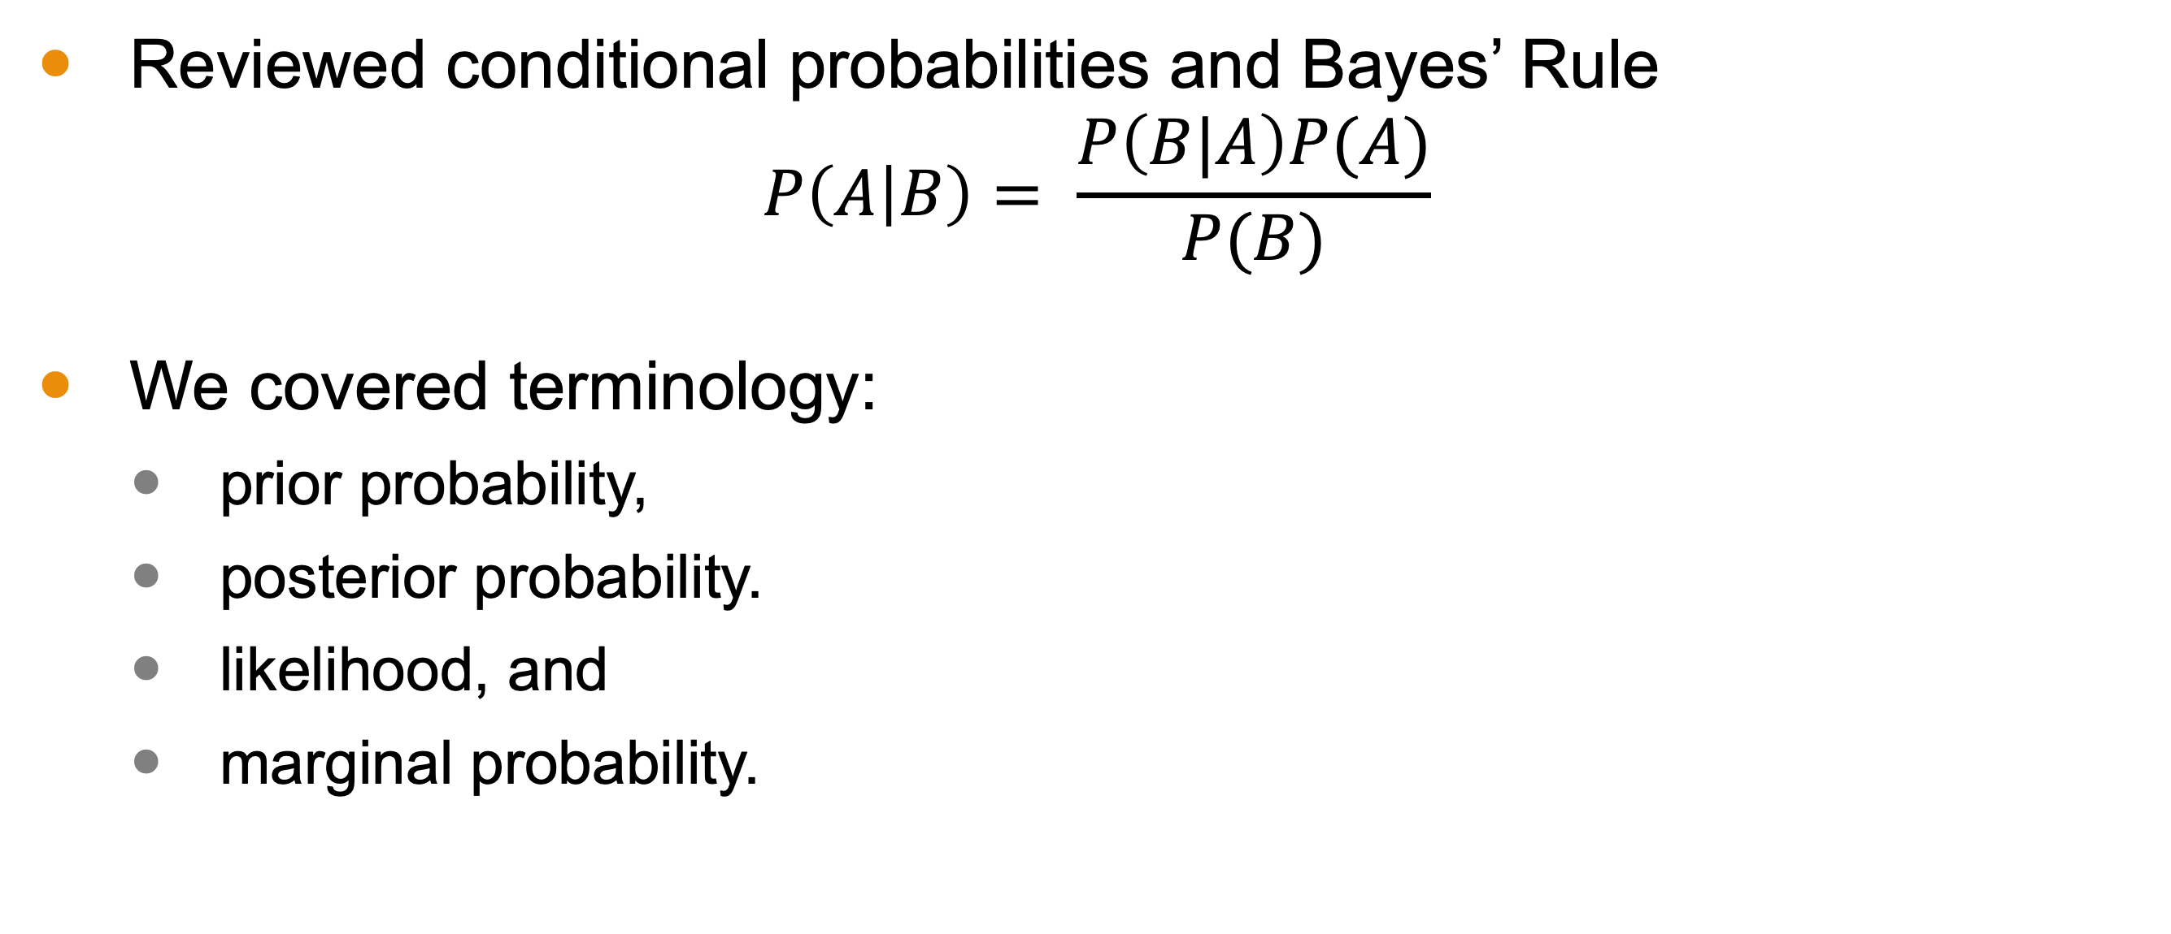
Last Time
Reviewed conditional probabilities and Bayes’ Rule
$$P\left(A | B\right)= \frac{P\left(B|A\right)P(A)}{P(B)}$$
We covered terminology:
prior probability,
posterior probability.
likelihood, and
marginal probability.
Notes:
In our last session, we reviewed conditional probabilities and Bayes’ Rule. We also covered important terminology such as prior probability, posterior probability, likelihood, and marginal probability.
We saw how we can use Bayes’ rule to update our beliefs in the face of evidence

Slide 4
Review of Practice Problem
Suppose you wish to determine if a coin is fair (meaning that heads and tails are equally likely outcomes). You believe that the chance the coin is fair is more likely (suppose 0.66) than not (0.34). You perform an experiment and flip the coin 5 times, all of which turn up heads. Using Bayes’ rule, what would you estimate to be the probability that the coin is fair given the data you have collected?
Notes:
Before we dive into the material, we had a question from the last lesson’s practice assessment. I’d like to walk through the solution here. I won’t generally do this, but because Module 1 is so fundamental, I would like to do that here.
Suppose you want to determine if a coin is fair, with an initial belief that it is fair with a probability of 0.66. After flipping the coin 5 times and getting heads each time, how would you use Bayes’ Rule to estimate the probability that the coin is fair given this data?”

Slide 5
(board example inserted here)

Slide 6
Objectives
Use the three steps of Bayesian data analysis:
specifying a prior probability distribution,
observing data, and
updating the prior distribution with the observed data.
Notes:
This lesson’s objectives are to understand and apply the three steps of Bayesian data analysis: specifying a prior probability distribution, observing data, and updating the prior distribution with the observed data.

Slide 7

Bayesian Inference
Bayesian inference is the process of fitting a probability model to a set of data utilizing Bayes’ rule.
The model is the deliverable.
Bayesian inference has several applications, including
science,
engineering,
medicine,
sports, and
law.
From Microsoft stock images
Notes:
Bayesian inference involves fitting a probability model to a set of data using Bayes’ Rule. This model is the deliverable of Bayesian analysis, with applications in fields such as science, engineering, medicine, sports, and law.

Slide 8
Three Steps of Bayesian Data Analysis
Set up a full probability model.
This is a joint probability distribution for all observable and unobservable quantities in a problem.
It is based on the knowledge about the underlying scientific problem and the data collection process.
Condition on observed data.
Calculating the posterior distribution using Bayes’ rule based on the observed data.
Evaluate and interpret that model.
Notes:
There are three key steps in Bayesian data analysis.
First, set up a full probability model,
which includes a joint probability distribution.
It should be based on knowledge about the process.
Second, condition on the observed data
to calculate the posterior distribution using Bayes’ Rule.
Third, evaluate and interpret the model. What conclusions can we draw from the posterior distribution?

Slide 9
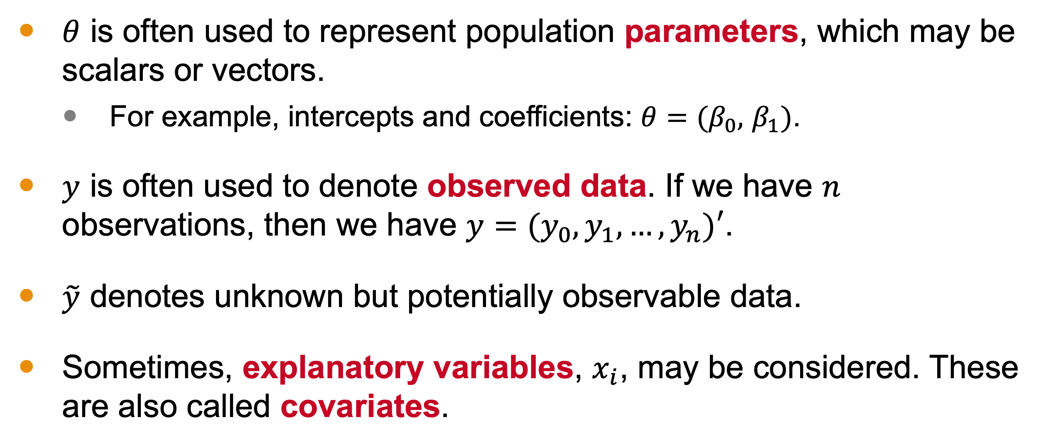
Notation
$θ$ is often used to represent population parameters, which may be scalars or vectors.
For example, intercepts and coefficients: $θ=(β_{0},$ $β_{1})$.
$y$ is often used to denote observed data. If we have $n$ observations, then we have $y=(y_{0},y_{1}, …,y_{n})′$.
$\tilde{y}$ denotes unknown but potentially observable data.
Sometimes, explanatory variables, $x_{i}$, may be considered. These are also called covariates.
Notes:
In Bayesian inference,
θ represents population parameters, which can be scalars or vectors,
such as intercepts and coefficients.
Y denotes observed data, with Y1, Y2, …, Yn representing n observations.
Y-hat denotes unknown but potentially observable data.
X sometimes denotes explanatory variables, also known as covariates.

Slide 10

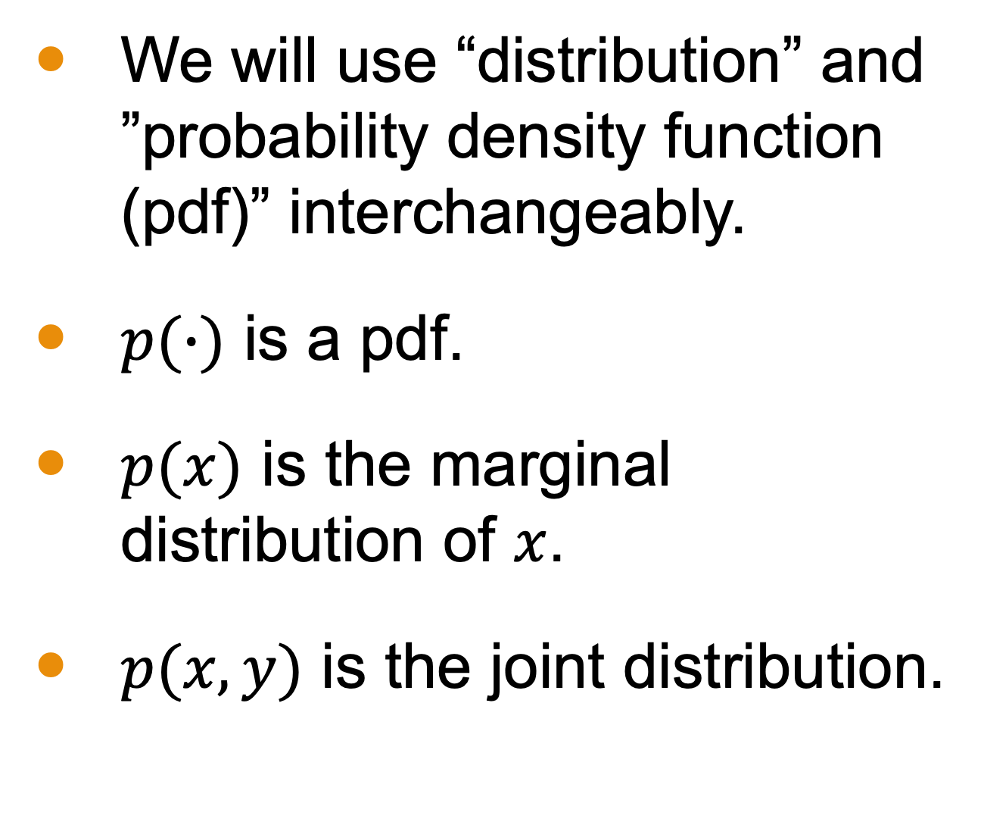
A Remark about Distributions
We will use “distribution” and ”probability density function (pdf)” interchangeably.
$p(∙)$ is a pdf.
$p(x)$ is the marginal distribution of $x$.
$p(x,y)$ is the joint distribution.
From Microsoft stock images
Notes:
In this class, we often use ‘distribution’ and ‘probability density function (pdf)’ interchangeably.

Slide 11
(board examples inserted here)

Slide 12

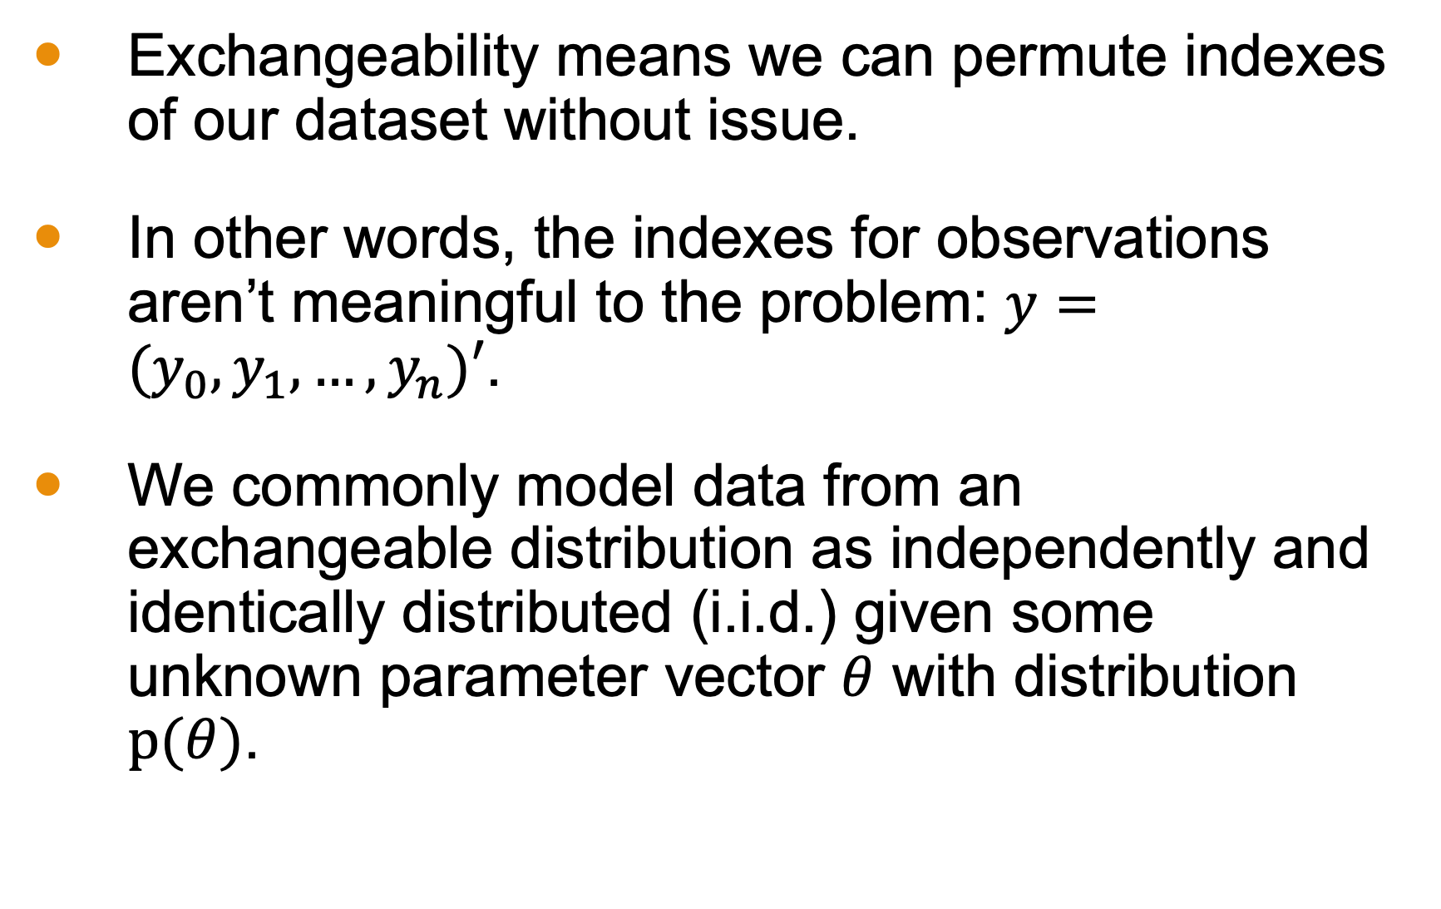
Exchangeability
Exchangeability means we can permute indexes of our dataset without issue.
In other words, the indexes for observations aren’t meaningful to the problem: $y=(y_{0},y_{1}, …,y_{n})′$.
We commonly model data from an exchangeable distribution as independently and identically distributed (i.i.d.) given some unknown parameter vector $θ$ with distribution $p(θ)$.
From Microsoft stock images
Notes:
Exchangeability means we can permute the indexes of our dataset without issue. This implies that the order of observations doesn’t affect the problem. We commonly model data from an exchangeable distribution as independently and identically distributed (i.i.d.) given some unknown parameter vector θ with distribution P(θ).

Slide 13

Subjectivity and Objectivity
Bayesian statistics relies heavily on priors.
Remember, these even inform how we compute posterior.
The choice of prior can seem subjective.
It can be based on expert opinion, idealizations, or even a wild guess.
Whenever there are many observations, estimates for features of a probability distribution will improve.
More data = better answers
Examples from the book:
Football point spreads
Record Linkage from the US Census
From Microsoft stock images
Notes:
Bayesian statistics heavily relies on priors, which can be subjective. These priors can be based on expert opinion, idealizations, or even guesses. However, with more observations, the estimates for features of a probability distribution will improve. Essentially, more data leads to better answers.

Slide 14
Next Time
Details on computational requirements
Notes:
In our next lesson, we will discuss the computational requirements for Bayesian inference in more detail.

